Slide 1
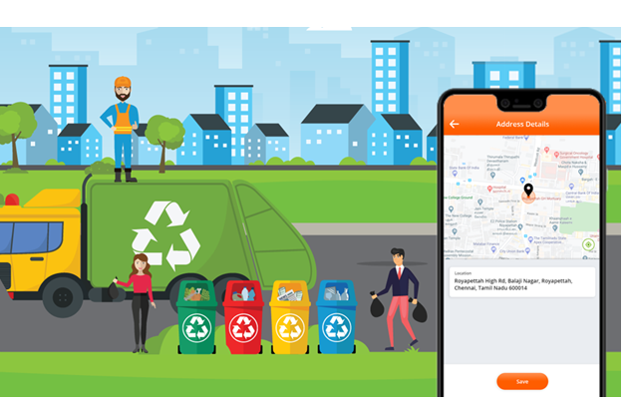
LOCATION BASED GARBAGE MANAGEMENT SYSTEM FOR SMART CITY

Slide 2
Presented By
NUZRATH.V.V
(MES21MCA-2037)
Product Owner
MUHAMMAD JABIR C
Asst. Professor
MES College of Engineering, Kuttippuram
Date : 30.03.2023, Thursday

Slide 3
CONTENTS
Introduction
Existing system
Proposed System
Module description
System Requirements
Data Flow Diagram
Product Backlog
User Story
Project Plan
Sprint Plan

Slide 4
INTRODUCTION
Smart cities integrate multiple mobile or web solutions to build a comfortable human habitation.One of these solutions is to provide an environmentally friendly, efficient and effective garbage management system. The current garbage collection system includes routine garbage trucks doing rounds daily or weekly, which not only does not cover every zone of the city but its completely inefficient use of government resources. The proposed system, where admin manage the garbage app for full online based monitoring and analyze the system. Her admin handle bins, driver, complaints from user and work report from driver. This paper proposes a cost-effective mobile or web based system for the government to utilize available resources to efficiently manage the overwhelming amounts of garbage collected each day, while also providing a better solution for the inconvenience of garbage disposal for the citizens. This is done by a driver, app will provide predictive and guide routes generated through for garbage trucks. Then driver update the status of work done will be data collected. An android or web app is developed for the work force and the citizens, which primarily provides the user create complaints available smart bin.

Slide 5
EXISTING SYSTEM
Employees heading for their workstations every morning.For all those people, there are just not enough garbage bins available. On the streets of urban cities, hundreds of people are passing the same location around one minute.
The obvious solution to this is for the cleaning staff to stay near garbage bins every day till they fill up to clean them. This is not a real solution.
There are some notable negative effects when considering the garbage bins always being full. One of the main effects is the surrounding area starting to smell and be very unpleasant.
When the garbage bins are full people put their trash on sides of the garbage bins.
Disadvantages
Time consuming and less effective: trucks go and empty containers whether they are full or not.
High costs.
Unhygienic Environment and look of the city.
Bad smell spreads and may cause illness to human beings.
More traffic and Noise

Slide 6
PROPOSED SYSTEM
The proposed system overview for this system. Solid waste management can be broadly categorized as segregation, collection, and transportation.
The server will collect the data and store them only a database. This data will be analyzed and displayed on two different dashboards that can be accessed by the workforce and clients.
Using data analytics, reports will be generated which can be monitored by the admins through the admin dashboard.
Based on the data collected, garbage trucks can be given routes generated through various algorithms and google maps API to efficiently route through all necessary garbage bins and finally reach the dumping site
Advantages
Real time information on the fill level of the dustbin.
Deployment of dustbin based on the actual needs.
Cost Reduction and resource optimization.
Improves Environment quality
Fewer smells & Cleaner cities
Intelligent management of the services in the city and effective usage of dustbins.

Slide 7
MODULES
A)Admin
1)Login
2)Add and Manage Drivers
3)Add and Manage Place
4)Assign places to Driver
5)View Users
6)Add and Manage Product
7)View booking Info
8)Awareness camp info
9)Manufacturing Videos
B)Drivers
1)Login
2)View assigned places
3)View notification
4)Send pick-up notification
5)Generate route info
6)Update status

Slide 8
MODULES
C)User
1)Registration
2)Login
3)Send Notification for pending delay
4)View pick-up notification
5)View product book.
6)View awareness camp info
7)View Video

Slide 9
SYSTEM REQUIREMENTS
HARDWARE REQUIREMENTS
Processor : Intel Pentium or above
RAM : 4GB or more
Storage :40GB hard disk and above

Slide 10
SOFTWARE REQUIREMENTS
Operating System : Windows 8 or above
Front-End : HTML,CSS,JAVASCRIPT,XML
Back-End : Python,JAVA
Database: MySQL
IDE: Android Studio/JetBrains PyCharm
FrameWork Used : DJANGO

Slide 11
DATA FLOW DIAGRAM

Slide 12
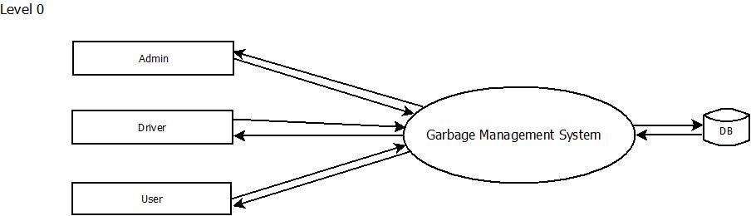
DATA FLOW DIAGRAM

Slide 13
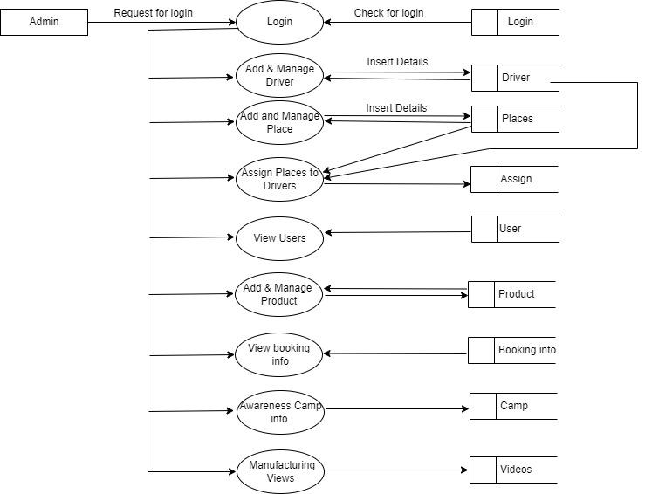
DFD LEVEL 1.1

Slide 14
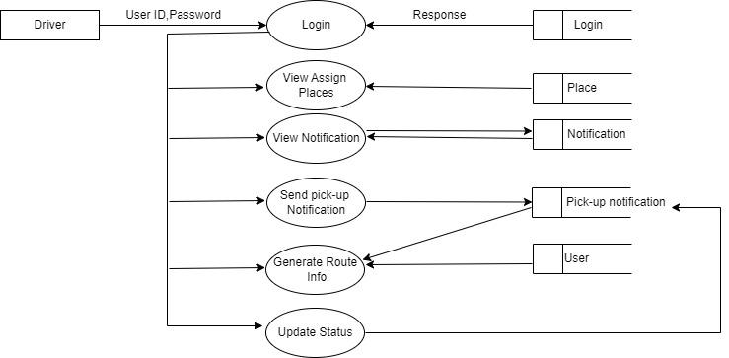
DFD-Level 1.2

Slide 15
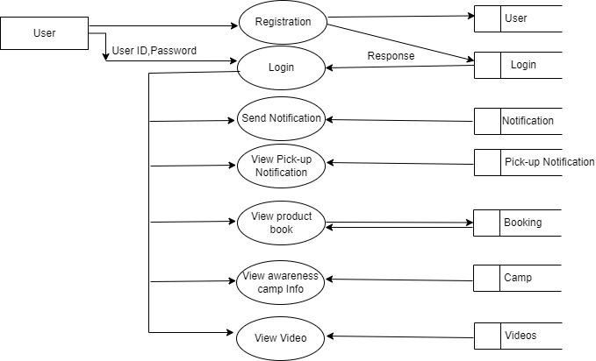
DFD-Level 1.3

Slide 16
PRODUCT BACKLOG
USER STORY_ID | NAME | PRIORITY
1 | Login | High
2 | Add & Manage Drivers | Medium
3 | Add & Manage Places | Medium
4 | Assign Places to Drivers | Low
5 | Login | High
6 | View Assigned places | Low
7 | Registration | Medium
8 | Login | High
9 | View Users | Low
10 | Send Notification | Low

Slide 17
USER STORY_ID | NAME | PRIORITY
11 | View Notification | Low
12 | Send pick-up notification | Low
13 | View Pick-up notification | Low
14 | Generate route info | Low
15 | Update Status | Low
16 | Add & Manage Product | Medium
17 | View Product Book | Low
18 | View Booking info | Low
19 | Awareness camp info | Low
20 | Manufacturing Videos | Low
21 | View Awareness camp info | Low
22 | View Video | Low

Slide 18
USER STORY
Story ID | As a<Type of user> | I want to | So that i can
1 | Admin | Login | Access entire page
2 | Admin | Add & Manage Drivers | Add, View, edit, Delete Drivers
3 | Admin | Add & Manage Places | Add, View, edit, Delete Places
4 | Admin | Assign Places to Drivers | Assign places to drivers
5 | Driver | Login | Access Driver his page
6 | Driver | View Assigned places | View assigned places
7 | User | Registration | User register
8 | User | Login | Access his page
9 | Admin | View Users | Admin View the users
10 | User | Send Notification | User send the notification

Slide 19
Story ID | As a<Type of user> | I want to | So that i can
11 | Driver | View Notification | Driver view the user notification
12 | Driver | Send pick-up notification | Send the pick-up notification to users
13 | User | View Pick-up notification | User view the pick-up notification
14 | Driver | Generate route info | Create route info according to user
15 | Driver | Update Status | Driver update the status after collection
16 | Admin | Add & Manage Product | Add, View, edit, Delete Product
17 | User | View Product Book | View the Product book detatils
18 | Admin | View Booking info | View the booking details from user
19 | Admin | Awareness camp info | Gave the awarenesscamp info
20 | Admin | Manufacturing Videos | Send the Manufactuaring videos
21 | User | View Awareness camp info | User view the awareness camp info
22 | User | View Video | View the Manufactuaring videos

Slide 20
PROJECT PLAN
UserStory_ID | Sprint | StartDate | EndDate | Day | Status
1 2 3 4 5 6 | Sprint 1 | 07/02/2023 | 28/02/2023 | 21 | Completed
7 8 9 10 11 | Sprint 2 | 01/03/2023 | 15/03/2023 | 15 | Completed

Slide 21
UserStory_ID | Sprint | StartDate | EndDate | Day | Status
12 13 14 15 16 17 | Sprint 3 | 16/03/2023 | 16/04/2023 | 28 | Ongoing
18 19 20 21 22 | Sprint 4 | 17/04/2023 | 15/05/2023 | 27 | Planned

Slide 22
SPRINT 1 PLAN
Backlog item | Status and completion date | original Estimate (hours) | Day 1 07/02 | Day 2 08/02 | Day 3 09/02 | Day 4 10/02 | Day 5 13/02 | Day 6 14/02 | Day 7 15/02 | Day 8 16/02 | Day 9 17/02 | Day 10 20/02 | Day 11 21/02 | Day 12 22/02 | Day 13 23/02 | Day 14 24/02 | Day 15 27/02 | Day 16 28/02 | Day 17 01/03 | Day 18 02/03 | Day19 03/03
UI designing | 10/02/23 | 4 | 2 | 1 | 1 | 0 | 0 | 0 | 0 | 0 | 0 | 0 | 0 | 0 | 0 | 0 | 0 | 0 | 0 | 0 | 0
Coding | 21/02/23 | 8 | 0 | 0 | 0 | 0 | 1 | 2 | 0 | 2 | 0 | 2 | 1 | 0 | 0 | 0 | 0 | 0 | 0 | 0 | 0
Testing | 03/02/23 | 6 | 0 | 0 | 0 | 0 | 0 | 0 | 0 | 0 | 0 | 0 | 0 | 1 | 0 | 1 | 0 | 2 | 2 | 0 | 0
Total |  | 18 | 2 | 1 | 1 | 0 | 1 | 2 | 0 | 2 | 0 | 2 | 1 | 1 | 0 | 1 | 0 | 2 | 2 | 0 | 0

Slide 23
SPRINT 2 PLAN
Backlog item | Status and completion date | original Estimate (hours) | Day 1 06/03 | Day 2 07/03 | Day 3 08/02 | Day 4 9/03 | Day 5 10/03 | Day 6 13/03 | Day 7 14/03 | Day 8 15/03 | Day 9 16/03 | Day 10 17/03 | Day 11 20/03 | Day 12 21/03 | Day 13 22/03 | Day 14 23/03
UI designing | 08/03/23 | 4 | 1 | 2 | 1 | 0 | 0 | 0 | 0 | 0 | 0 | 0 | 0 | 0 | 0 | 0
Coding | 17/03/23 | 12 | 0 | 0 | 0 | 3 | 1 | 2 | 0 | 3 | 1 | 2 | 0 | 0 | 0 | 0
Testing | 23/03/23 | 4 | 0 | 0 | 0 | 0 | 0 | 0 | 0 | 0 | 0 | 0 | 1 | 1 | 0 | 2
Total |  | 20 | 1 | 2 | 1 | 3 | 1 | 2 | 0 | 3 | 1 | 2 | 1 | 1 | 0 | 2

Slide 24
THANK YOU

